Slide 1
Seminar Rethinking Belady’s Algorithm to Accommodate Prefetching
sumon@cse.iitb.ac.in
Some of the figures are adapted and modified from the paper

Slide 2
10K-feet view
Belady’s optimal policy
(MIN)
DEMAND-MIN
FLEX-MIN
Not optimal when prefetcher is ON
Reduces demand miss
High memory traffic
Impractical
Hawkeye¹
Hawkeye*
Harmony
MIN
FLEX-MIN
[1] Jain, Akanksha, and Calvin Lin. "Back to the future: Leveraging Belady's algorithm for improved cache replacement." In 2016 ACM/IEEE 43rd Annual International Symposium on Computer Architecture (ISCA), pp. 78-89. IEEE, 2016.

Slide 3
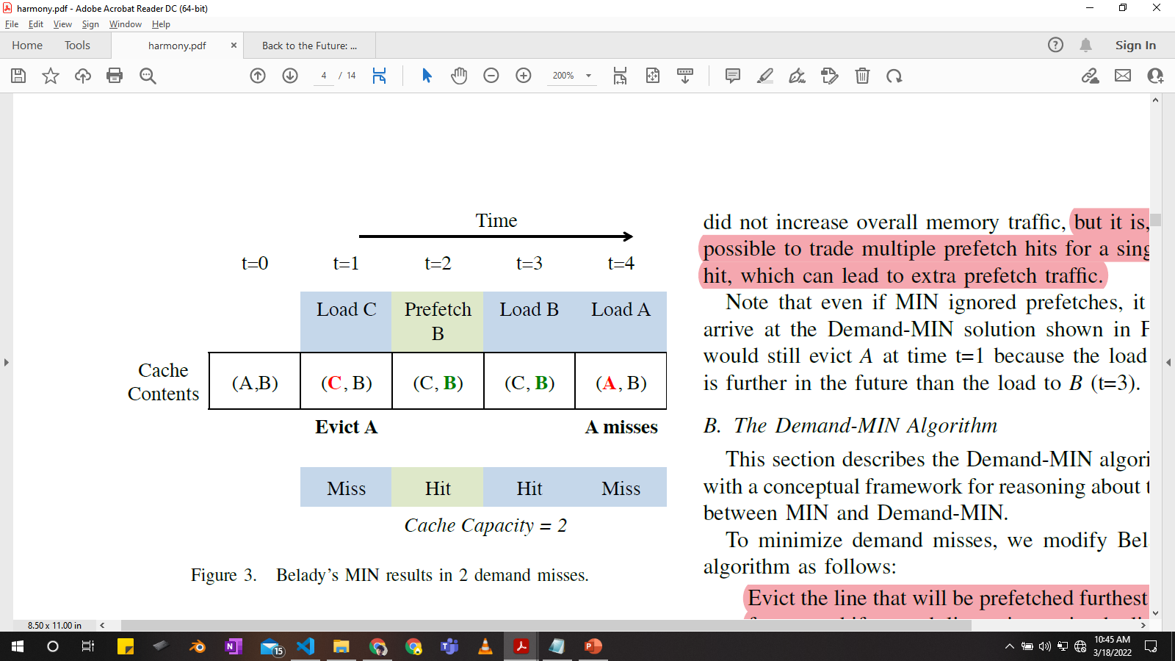
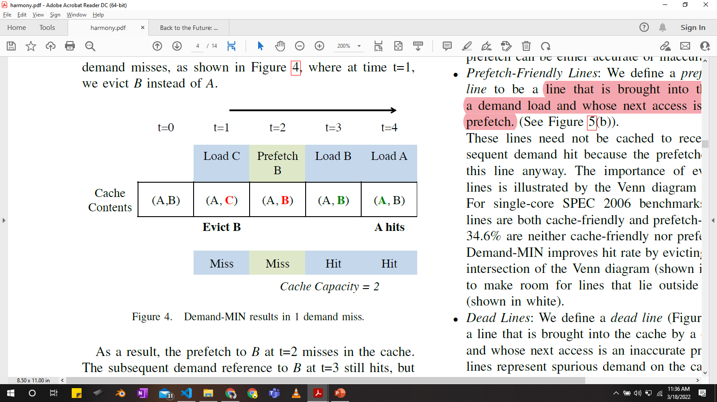
MIN not optimal for prefetches?
MIN: evict cache line that will be reused furthest in future
2 demand misses
1 demand miss + 1 prefetch miss
Reason: MIN does not differentiate between prefetch & demand access

Slide 4
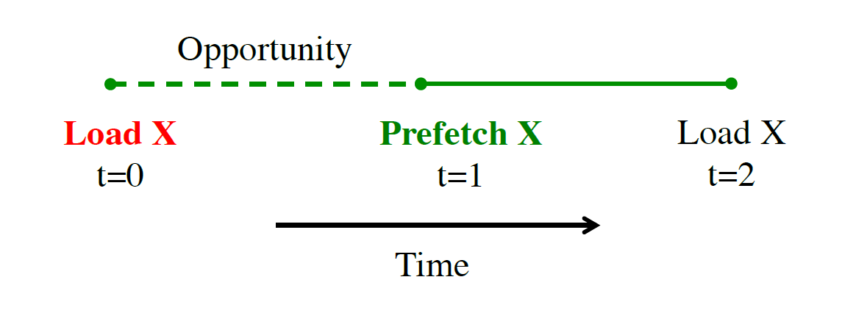
MIN: Opportunity
Opportunity window: D-P interval
(D: Demand, P: Prefetch)

Slide 5
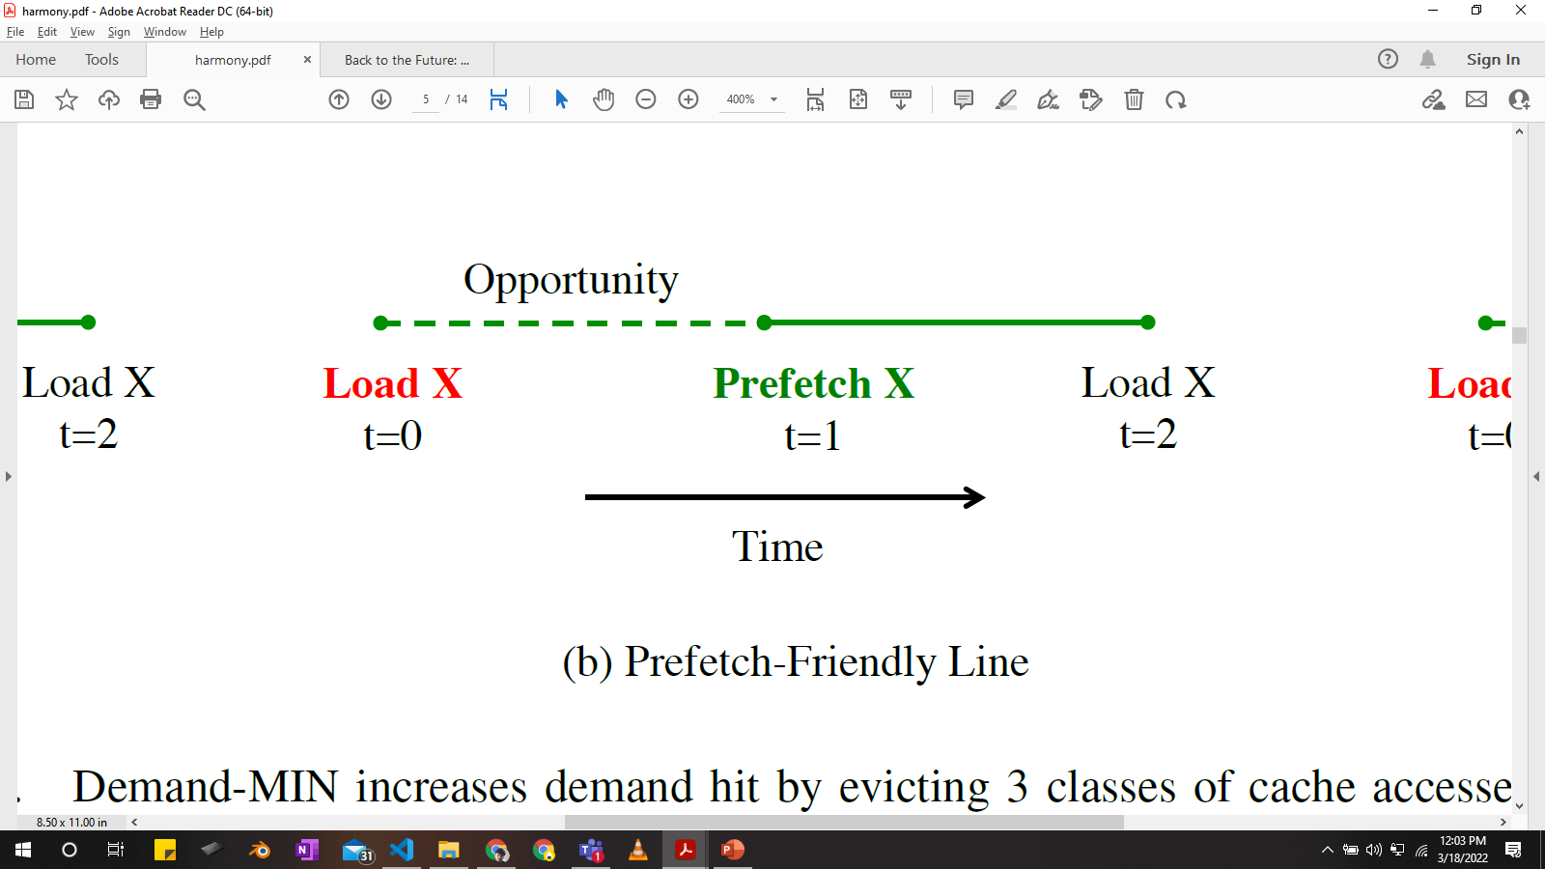
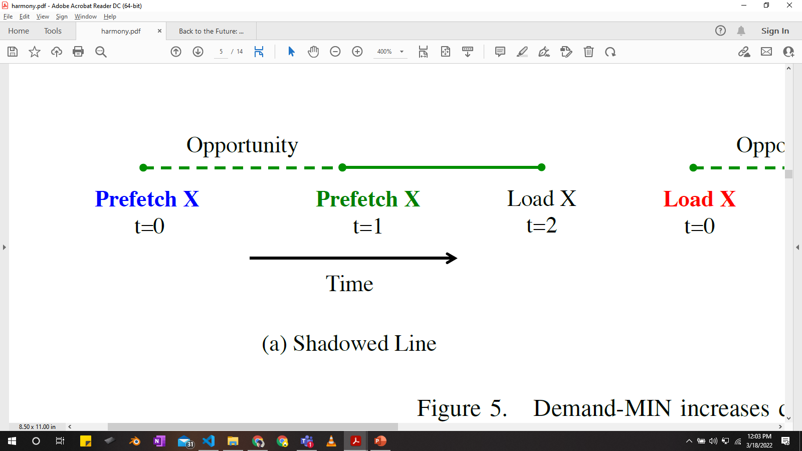
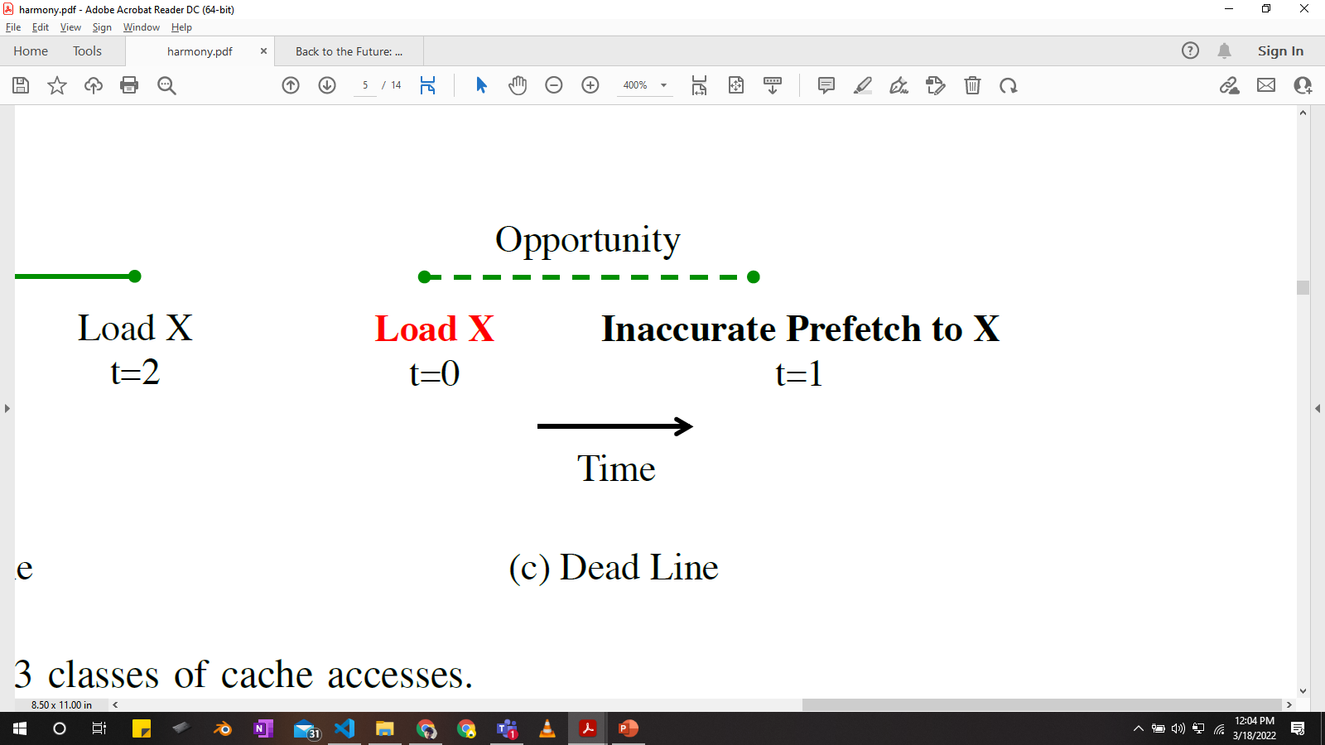
DEMAND-MIN
Evict line prefetched furthest in the future
Prefetch-friendly line
Shadowed Line
Increases prefetches ~ memory traffic
Dead Line

Slide 6
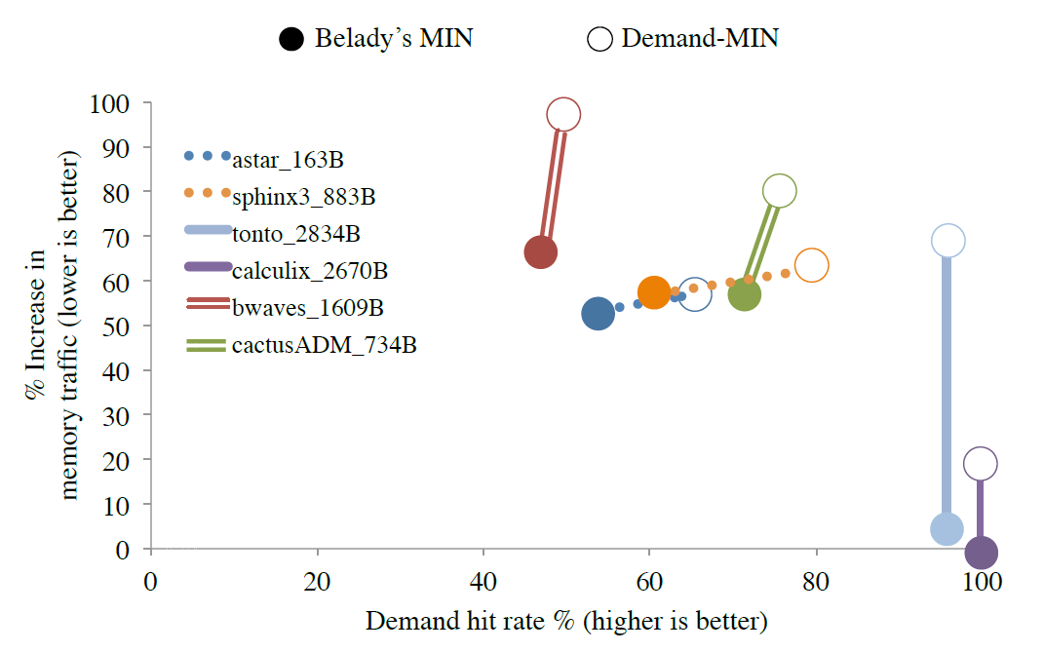
DEMAND-MIN: high memory traffic
DEMAND-MIN suffers from high memory traffic
Memory traffic varies in different benchmarks

Slide 7
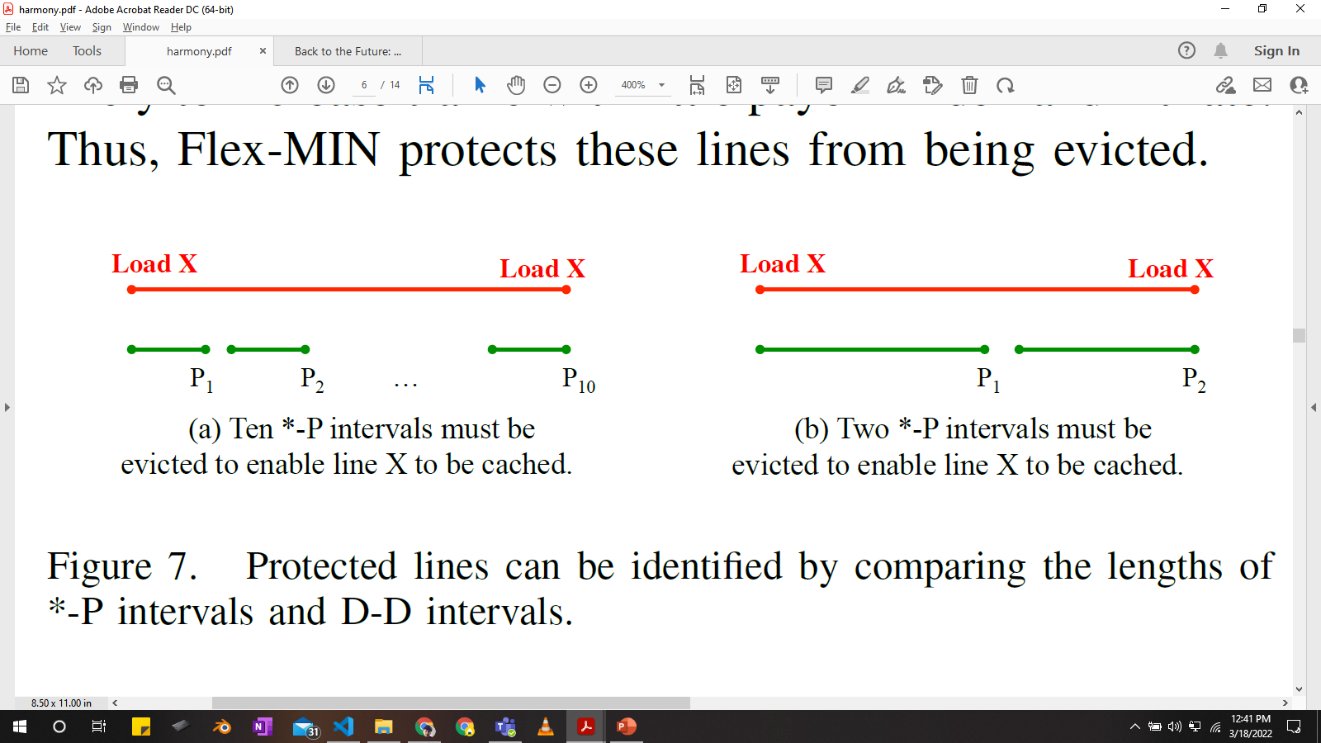
FLEX-MIN: protected lines
Evict 10 *-P intervals to keep line X in cache
Evict 2 *-P intervals to keep line X in cache
Do not evict lines with short *-P intervals
Protected Lines: lines belonging to *-P intervals
interval length > threshold*

Slide 8
FLEX-MIN: protected line threshold
Threshold: ratio avg length D-D intervals that miss in cache and avg length of *-P intervals
Lines evicted per Demand-Hit
Proxy for slope

Slide 9
FLEX-MIN
Evict line prefetched furthest in future and is not protected
DEMAND-MIN + protected line condition

Slide 10
So far
Belady’s optimal policy
(MIN)
DEMAND-MIN
FLEX-MIN
Not optimal when prefetcher is ON
Reduces demand miss
High memory traffic
Impractical
Practical solution

Slide 11
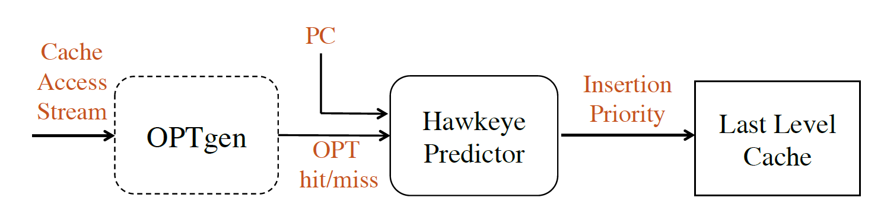
State-of-the-art: Hawkeye
Emulates Belady’s MIN policy
Learns from OPTgen’s decisions

Slide 12
Harmony
FLEX-MINgen
Uses FLEX-MIN instead of MIN to train predictor

Slide 13
Evaluation methodology
Simulator: Champsim
Prefetchers:
L1D : next-line prefetcher
L2C: PC-based stride prefetcher
Workload: SPEC2006
4-core: 100 mix
8-core: 50 mix

Slide 14
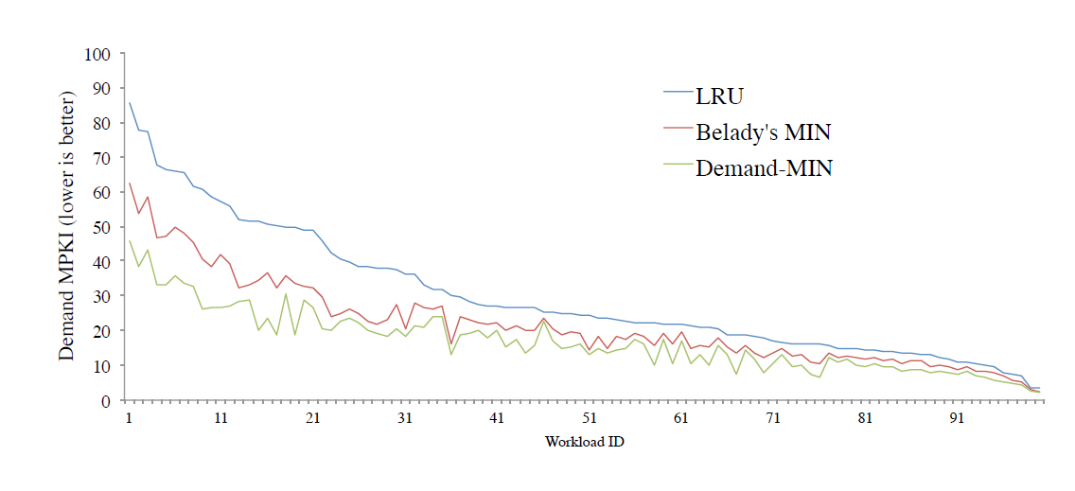
MIN vs DEMAND-MIN : MPKI
29.8
21.7
Takeaway: Low MPKI for DEMAND-MIN ☺

Slide 15
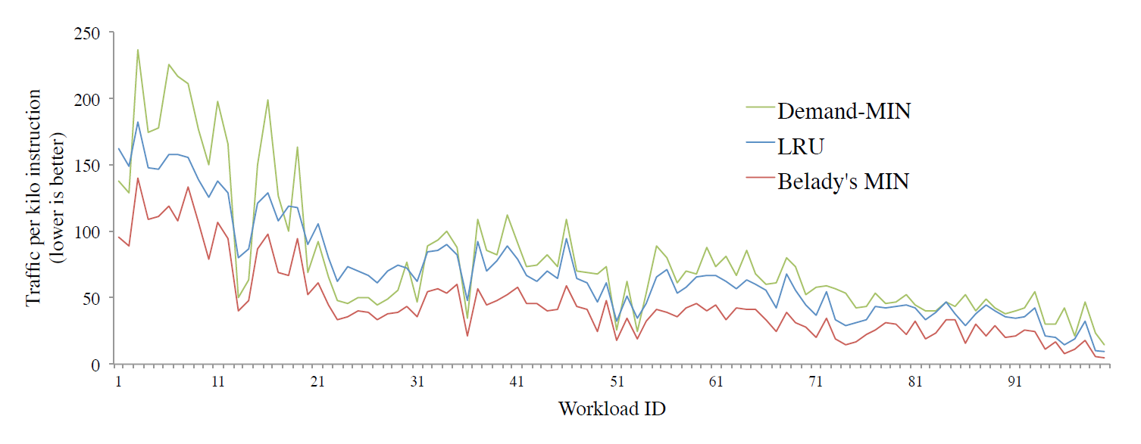
MIN vs DEMAND-MIN : TPKI
*Traffic : demand and prefetch misses
79.4
45.4
Takeaway: High TPKI for DEMAND-MIN ☹

Slide 16
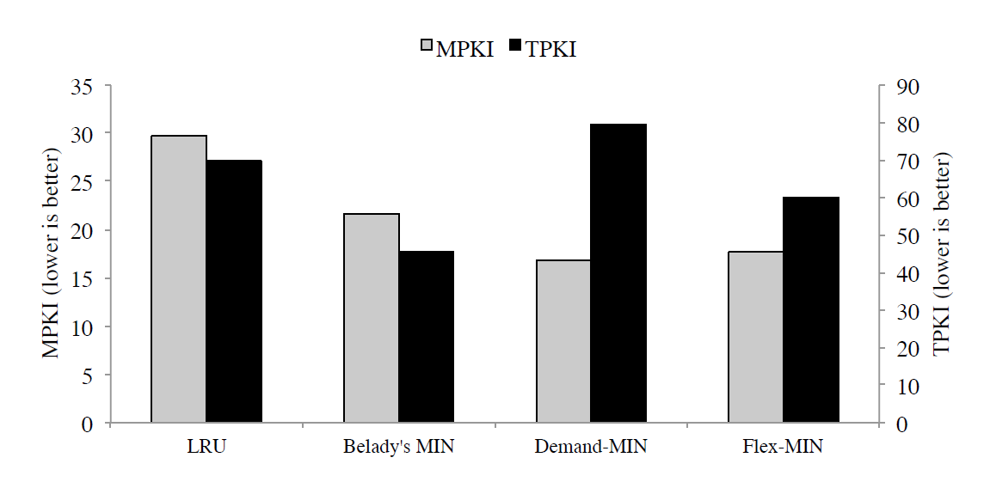
FLEX-MIN
Takeaway: FLEX-MIN achieves good tradeoff b/w MIN & DEMAND-MIN

Slide 17
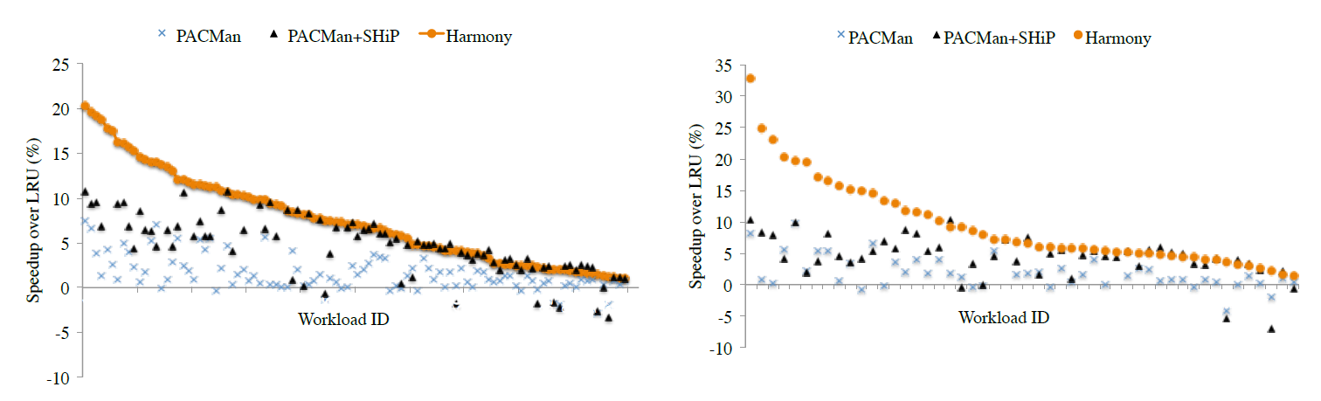
Performance improvement: Harmony
Performance improvement with Harmony 4-core : 7.7 %
8-core : 9.4 %

Slide 18
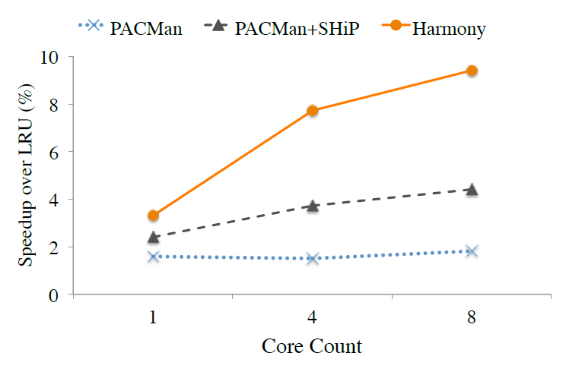
Performance improvement: Harmony
Higher speedup for more cores
FLEX-MIN good trade-off: hit-rate and memory traffic

Slide 19
Conclusion
Belady’s optimal policy not optimal with prefetcher
DEMAND-MIN optimal with prefetcher but high memory traffic
FLEX-MIN good trade-off between MIN and DEMAND-MIN
Harmony modifies Hawkeye to use FLEX-MIN instead of MIN

Slide 20
Thank You

Slide 21
Limitation
Does not target inaccurate prefetches

